Slide 1




AI-Driven Roadmap App and Website for Students
Team members : Anurag Kumawat :- 21CS11
Vidhita Sharma :- 21CS90
Karan Rathore :- 21CS38
Shraddha Sharma :- 22CS108D
Supervisor: Mr. H R Choudhary

Slide 2


AGENDA
1. Introduction
2. Project Objectives
3. Technology Stack
4. System Architecture
5. AI-Powered Features
6. Development Process
7. Challenges Faced
8. Conclusion

Slide 3


Introduction
Problem Statement: Students struggle to find the right learning resources to achieve their career objectives. This platform solves that problem with personalized roadmaps.
This project aims to help students create personalized roadmaps based on their skills, education, and career goals using AI.

Slide 4
Project Objectives
The project aims to create a user-friendly platform that offers tailored academic resources, enhancing student engagement through interactive features and personalized learning pathways. By utilizing AI to analyze student performance, the platform will provide targeted suggestions for improvement. This approach addresses the limitations of traditional education methods, fostering a more customized and effective learning experience for students.
Provide a seamless experience for students to identify learning paths based on their skills and career goals.
Deliver AI-powered recommendations to help students achieve milestones.
Enable students to track their progress and update their roadmap accordingly.

Slide 5
Technology Stack
This combination of technologies supports the development of an engaging and responsive educational platform by ensuring that each component works harmoniously to enhance user experience and performance.
• Frontend: Dart (Mobile), Flask(Web)
• Backend: Flask (Python)
• Database: MySQL or MongoDB
• AI Models: TensorFlow/Keras or PyTorch
• Cloud: basic hosting platform, Firebase for ….authentication

Slide 6
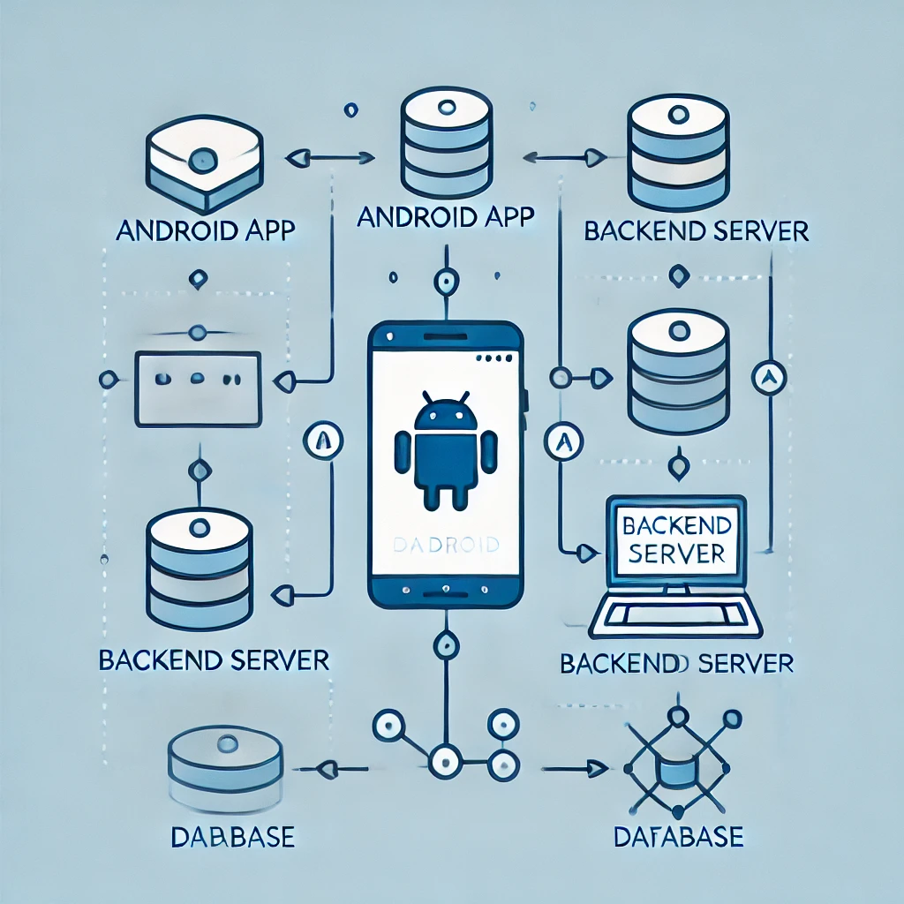
System Architecture
The backend manages application logic and interacts with database for flexible data storage
Mobile App & Website → API Gateway → Backend Server → AI System & Database → Cloud Storage for resources

Slide 7
AI-Powered Features
The platform offers personalized learning paths that tailor study schedules and resources based on individual performance. An intelligent tutoring system provides real-time support, while performance analytics track progress and identify improvement areas.
Personalized questionnaire capturing student details.
AI-driven roadmap generation based on student input.
Curated content recommendations.
Progress tracking and dynamic roadmap updates.

Slide 8
Development Process
The development process begins with planning and requirements gathering, where project goals and user needs are defined. Next, wireframes and prototypes are created to visualize the user interface
• Initial planning and feature definition
• UI/UX Design
• Frontend and Backend development
• AI Model Training
• Integration, Testing, and Debugging

Slide 9
Challenges Faced
Throughout the development process, several challenges emerged. Ensuring data privacy and security was paramount, requiring robust measures to protect sensitive student information and comply with regulations.
• Integrating dynamic AI with user-specific data.
• Ensuring secure authentication.
• Optimizing performance while managing …complex algorithms.
• Scalability for future growth.

Slide 10
Conclusion
The AI roadmap outlines a strategic approach to developing and integrating AI features into the educational platform. Starting with research and prototype development, it progresses through AI model training and testing, culminating in deployment and continuous improvement.
• Summary: We developed an AI-driven …app/website that provides personalized …roadmaps to students based on their skills and …goals.
• Potential Impact: Transforming students’ learning …journeys with relevant content and …recommendations.
………….. THANK YOU ……………

